Slide 1
Software Quality Assurance

Slide 2
Getting Started
Definition:
Quality assurance (QA) is a systematic pattern of activities intended to ensure that a product properly satisfies the needs and desires of its stakeholders.
Activities:
Validation is the process of determining if a product (or its specification) satisfies stakeholders’ needs and desires ("Are we building the right product?")
Verification is the process of determining if a product (or its specification) satisfies those needs and desires properly ("Are we building the product right?")

Slide 3
An Example
The Setting:
You are a newspaper reporter and you are told to write an article about homelessness (the product)
Validation:
You must write about homelessness
Note: All validation activities are product specific
Verification:
You must write properly (e.g., use proper grammar, follow the newspaper's style guide, make a compelling argument)
Note: Some verification activities are product-specific (e.g., the quality of the argument) and some are not (e.g., proper grammar)

Slide 4
Software Quality - History
Conformance to Specifications (Crosby, 1979):
Items that are verified (i.e., the reliability, robustness, and safety of the product)
Customer Satisfaction (Feigenbaum, 1983):
Items that are validated (i.e., the adequacy of the product)

Slide 5
History (cont.) - Boehm et al. (1978)
As-Is Utility:
Portability
Reliability
Efficiency
Human Engineering
Maintainability:
Testability
Understandability
Modifiability

Slide 6
History (cont.)
Garvin (1984):
Transcendental View - I know it when I see it
User View - fitness for purpose
Manufacturing View - conformance to specifications
Product View - tied to inherent product characteristics
Value-Based View - tied to what the customer is willing to pay
Garvin (1988):
Performance
Features
Reliability
Conformance

Slide 7
Software Quality - ISO/IEC 25010
Functional Suitability:
Functional completeness, correctness, and appropriateness
Performance Efficiency:
Processing times and throughput rates, resources used, capacity
Compatibility:
The degree to which the product can co-exist with and interoperate with other products

Slide 8
Software Quality - ISO/IEC 25010 (cont.)
Usability:
Understandability, learnability, and operability
Security:
Confidentiality, integrity, authentication, and accountability
Maintainability:
Modifiability/Adaptability and reusability

Slide 9
Software Products vs. Large-Scale Engineering Products
Examples:
Structures (bridges, buildings, dams)
Networks (e.g., roads, water, electrical, communication)
How is Quality Defined?
In very similar ways
Functional Suitability
Performance Efficiency
Compatibility
Usability
Security
Maintainability

Slide 10
Software Products vs. Manufactured Products
Other Products:
After the product is designed and engineered it must be produced/manufactured and each instance is different
The concern is often with the quality of the instances of the product (sometimes called "quality control")
Software Products:
After the product is designed and engineered each instance is identical
The concern is with the quality of the product

Slide 11
Defect Elimination:
Defects:
Any undesirable aspect of a product
Defect Elimination Activities:
Detection and Removal
Prevention

Slide 12
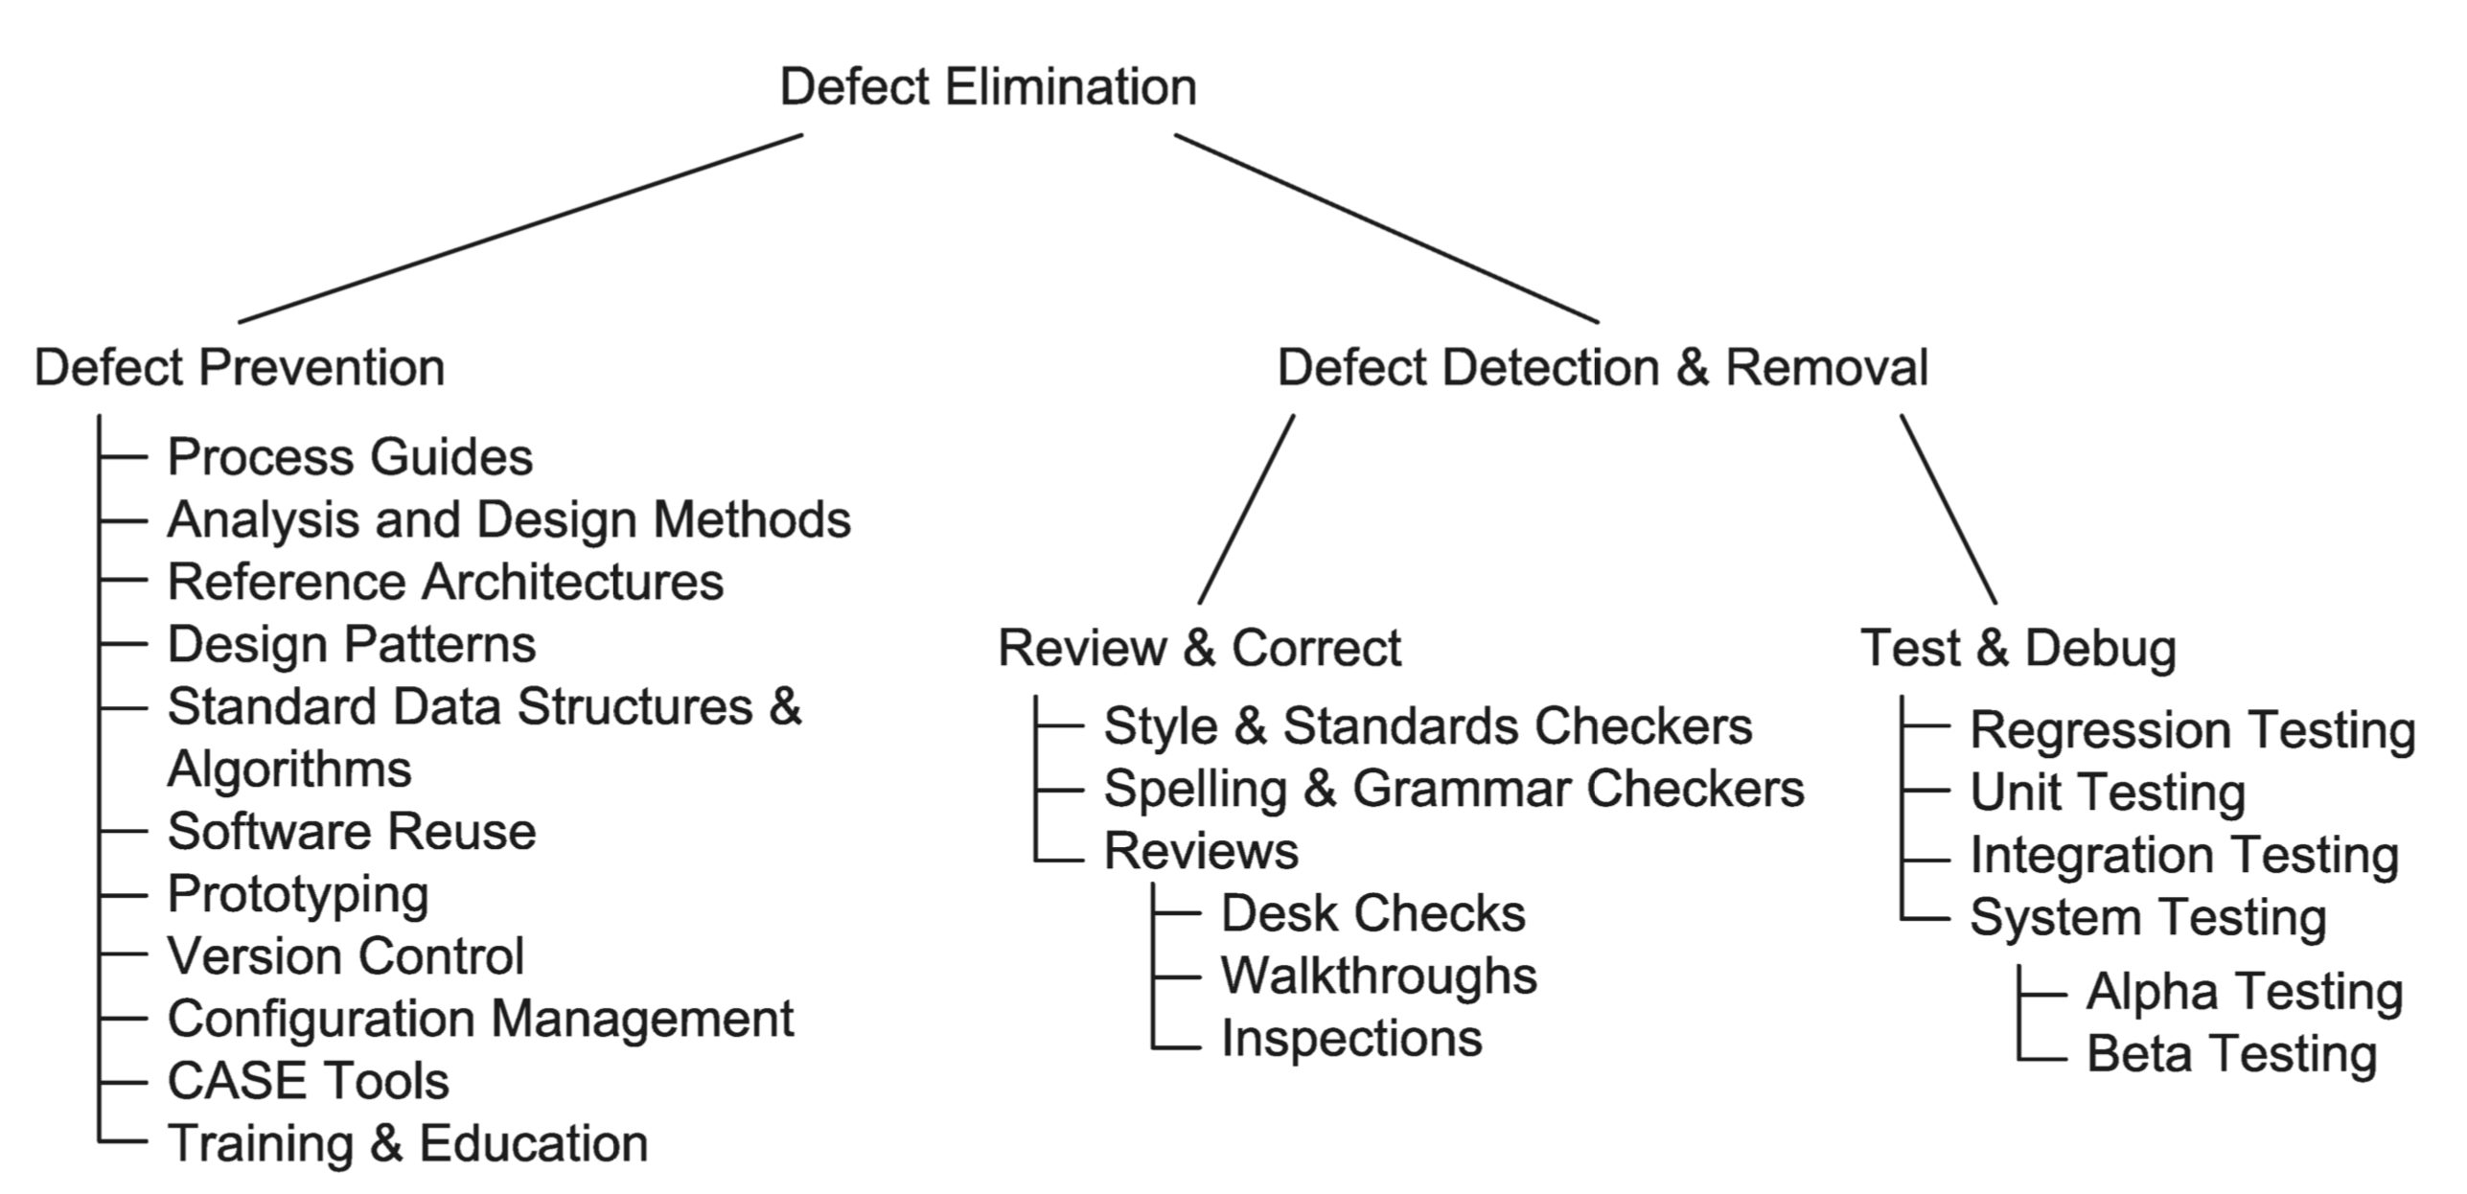
Defect Elimination:

Slide 13
Defect Prevention
Process Guides:
Standards and guidelines that describe the way everyone in the organization should behave
Templates and checklists that make it easier to do so
Analysis and Design Methodologies:
Well-codified approaches to understanding and solving software-related problems (e.g., OO)
Well-Studied Solutions:
Reference architecture
Design patterns

Slide 14
Defect Prevention (cont.)
Prototypes:
Throwaway/Exploratory
Evolutionary
Tools:
Version/configuration management
Computer-aided software engineering (CASE)

Slide 15
Defect Detection and Removal
Review and Correct:
Automated tools
Manual techniques (e.g., desk-checks, walk-throughs, inspections)
Test and Debug:
Testing is a validation and verification process that makes use of the system/product (including prototypes) while it is in operation or being operated on

Slide 16
An Abstract View of Testing

Slide 17
Quality of the Process
An Observation:
Many activities affect product quality
Questions One Might Ask:
When are we finding particular validation problems and can we find them earlier?
When are we finding particular verification problems and can we find them earlier?
Implications:
The quality of the process can be an important determiner of the quality of the product

Slide 18
Organizing for Quality
Root Causes of Quality Problems:
Management tends to blame workers
Workers tend to blame managers
Implications (Feigenbaum, 1983):
Quality shouldn't be the responsibility of a single department
Quality must be part of the entire process

Slide 19
Approaches/Methodologies/Standards
Quality Circles:
A small group that meets on a regular basis to consider quality issues for its "department" and make recommendations to management
Six Sigma (ISO 13053:2011):
Plan-Do-Check-Act (Deming)
Continuously monitor products and processes (engineering and management processes)
Focus on achieving measurable improvements and confirming them with statistical analyses
Well-Defined Rolls (Executives, Champions, Master Black Belts, Black Belts, Green Belts)
ISO 9001:
Must have a formal statement of a quality policy that is understood and applied at all levels
Must make decisions based on audited data
Must communicate with the customer and obtain feedback from the customer

Slide 20
Approaches/Methodologies/Standards (cont.)
Capability Maturity Model (CMM):
Initial
Repeatable (requirements management, project planning, project tracking)
Defined (process focused, integrated management, peer reviews, coordination)
Managed (quantitative)
Optimizing (fault prevention, change management)
http://searchsoftwarequality.techtarget.com/definition/Capability-Maturity-Model
Software Process Improvement and Capability Determination (SPICE) - ISO15504:
Performed informally
Planned and tracked
Well-defined
Quantitatively controlled
Continuously improving
http://searchsoftwarequality.techtarget.com/definition/Software-Process-Improvement-and-Capability-dEtermination
Notes:
At the initial level, processes are disorganized, even chaotic. Success is likely to depend on individual efforts, and is not considered to be repeatable, because processes would not be sufficiently defined and documented to allow them to be replicated.
At the repeatable level, basic project management techniques are established, and successes could be repeated, because the requisite processes would have been made established, defined, and documented.
At the defined level, an organization has developed its own standard software process through greater attention to documentation, standardization, and integration.
At the managed level, an organization monitors and controls its own processes through data collection and analysis.
At the optimizing level, processes are constantly being improved through monitoring feedback from current processes and introducing innovative processes to better serve the organization's particular needs.

Slide 21
The Quality Tradeoff
Costs of Low Quality Software:
Negligence and liability costs
Security costs
Disgruntled customers (hence lost sales)
Costs of High Quality Software:
Prevention costs
Appraisal costs
Delays to market (hence lost sales)

